Slide 1

Western Renewables
Salt Lake City, Utah

Slide 2


Who are we?
Ian Whicker
Gavin Haig
EIS Lead
Supply Lead

Slide 3
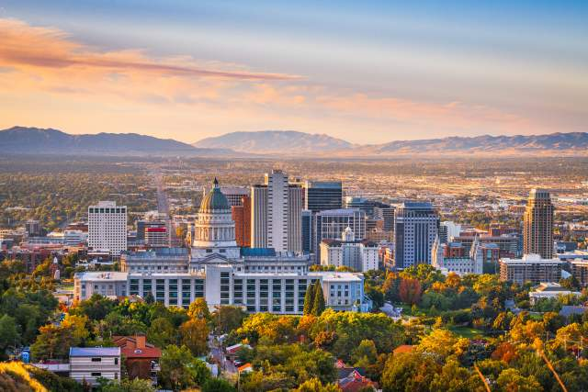
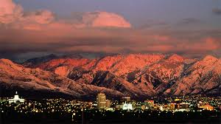
Community Narrative
Utah Environment
Families & Population
Dry/Arid
Mountainous
Population - 199,743
Families - 98,916

Slide 4


Current Renewables
The Elektron Solar Project
2016 - City leaders establish renewable goals
April 25, 2024 - Solar farm operations go live
Wasatch Resource Recovery
(WRR) anaerobic digestion facility, North Salt Lake City - Began receiving food waste in 2019.
Utilizes - wastewater and solid waste
Notes:
2016 - City leaders established several municipal and community goals to reduce carbon emissions and support renewable energy.
April 25, 2024 - Commercial operation and began providing renewable electricity.

Slide 5
Energy Supply
Gavin Haig

Slide 6
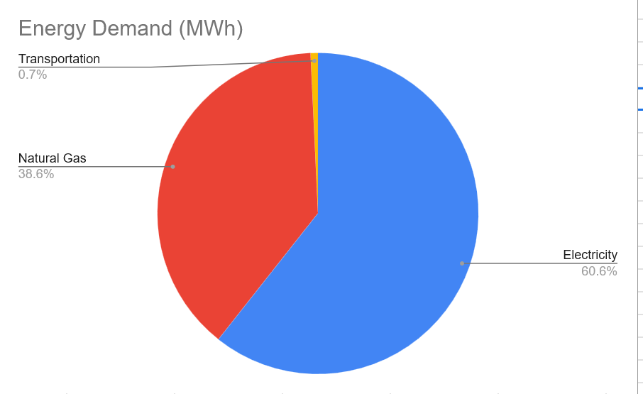
Energy Demand
Electricity
Natural Gas
Transportation
Total
2,270,602 MWh
1,446,069 MWh
27,797 MWh
3,744,468 MWh
20% Increase 4,493,361 MWh
Existing Renewables 656,000 MWh
= 3,837,361 MWh Annual Demand

Slide 7
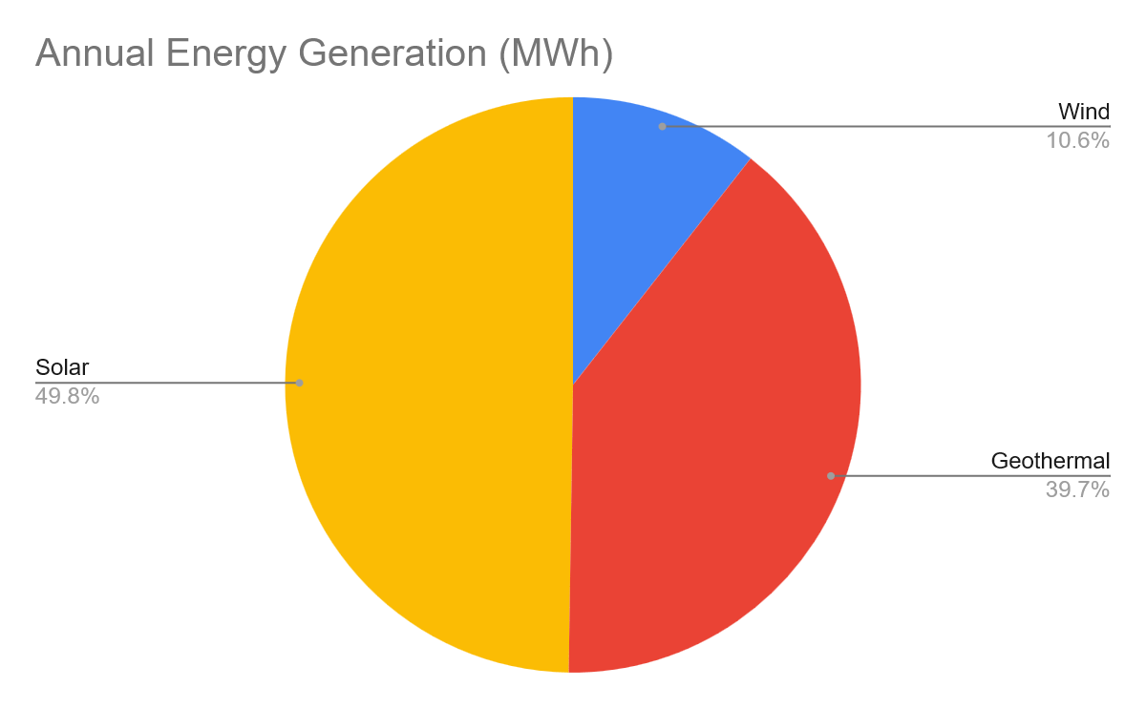
Renewable Sources
Solar
Wind
Geothermal
Total
1,917,531 MWh
407,408 MWh
1,527,907 MWh
3,853,283 MWh
3,853,283 MWh > 3,837,361 MWh

Slide 8
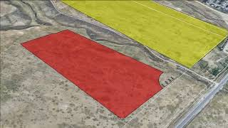
Fly through

Slide 9
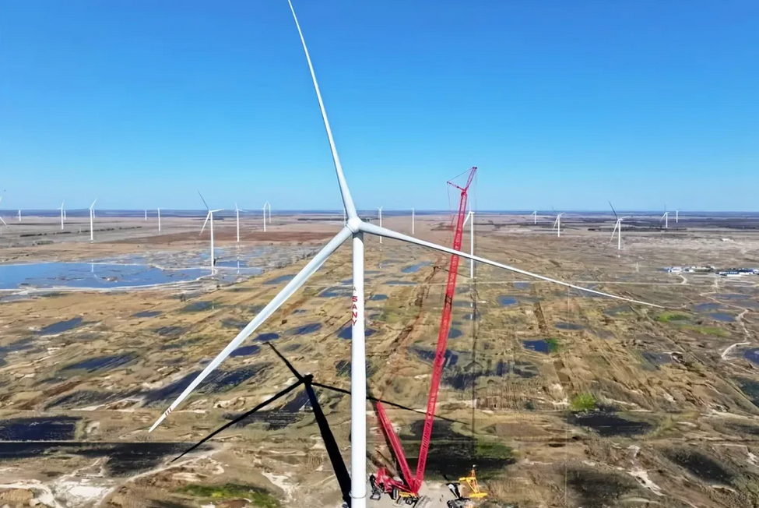
Development Discussion: Wind
3 Arrays of 1EA 15MW RWT Turbines
Max Power: 315 MW
11% of Total Energy
LCOE of $0.14

Slide 10
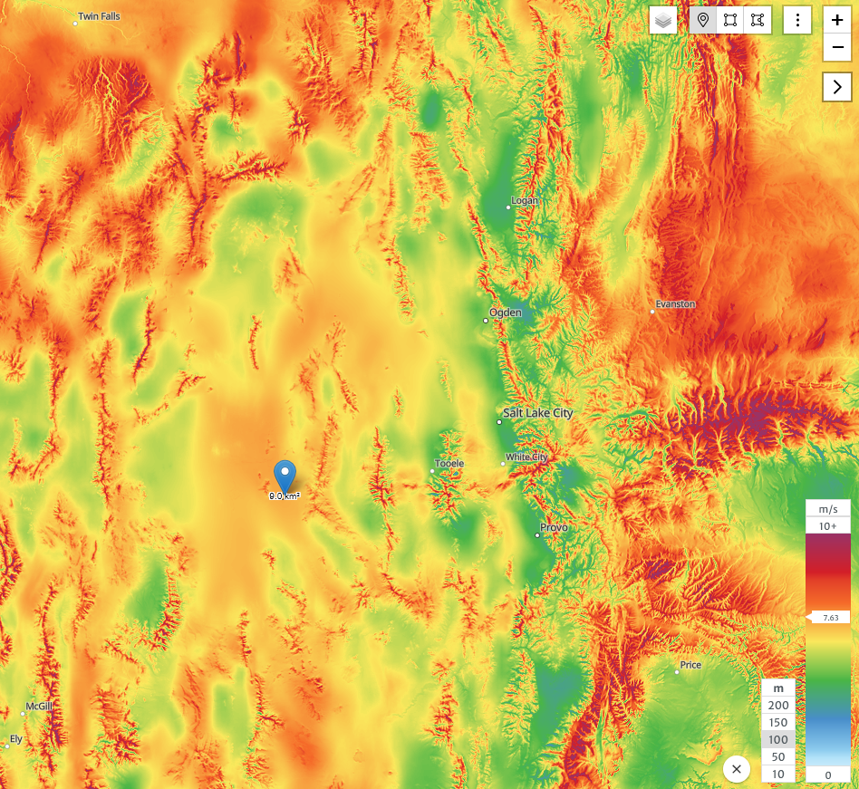
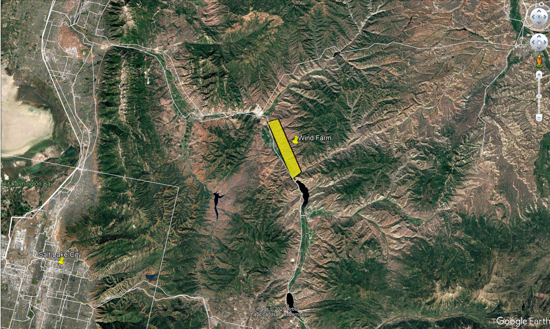
Wind Farm Location

Slide 11
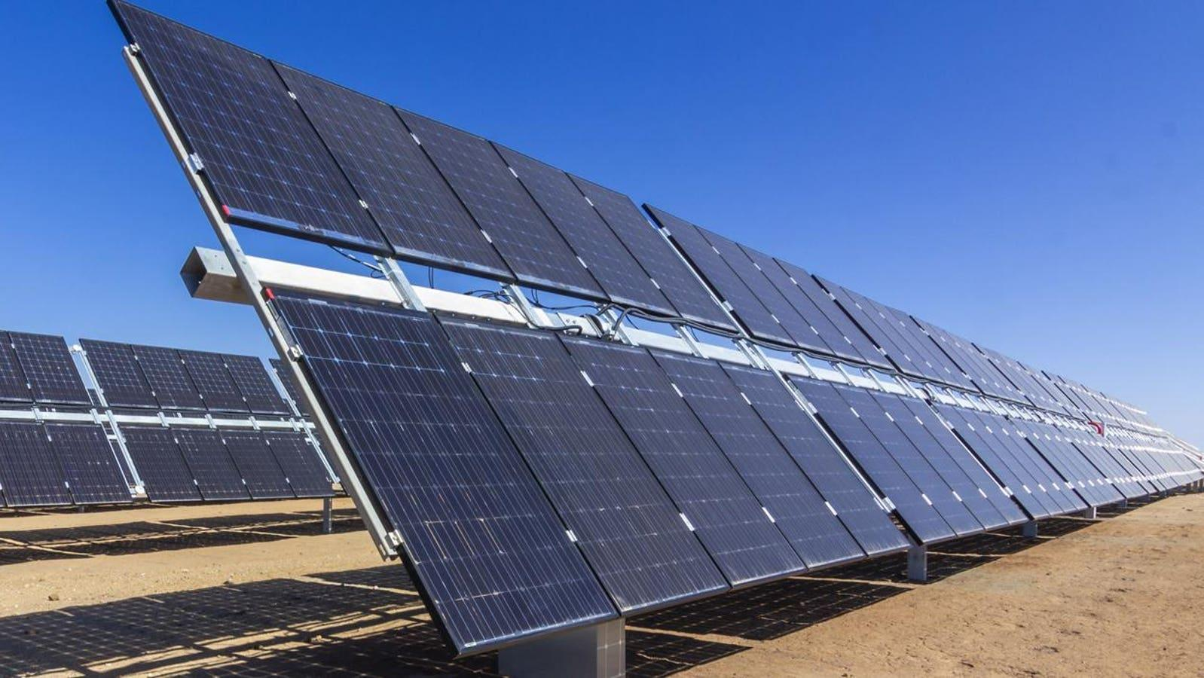
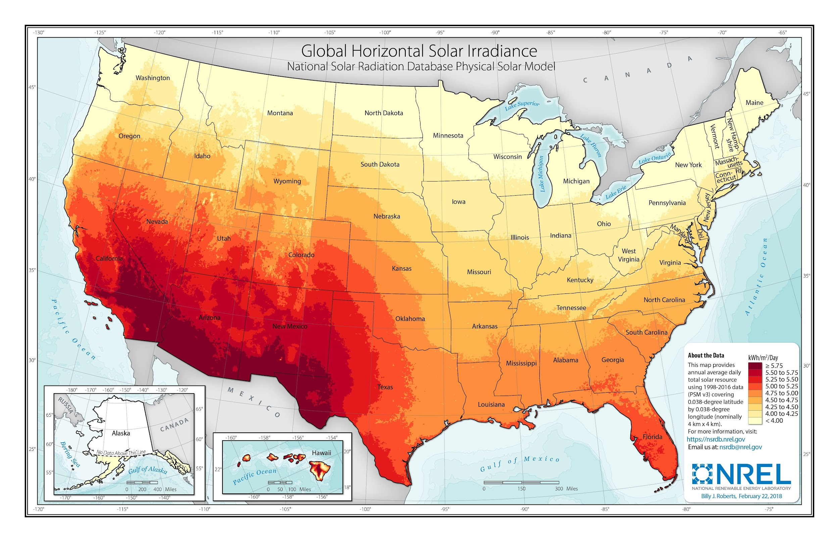
Development Discussion: Solar
2-Axis Solar Panels
Bi-Facial
Max Power: 769 MW
50% of Total Energy
LCOE of $0.06

Slide 12
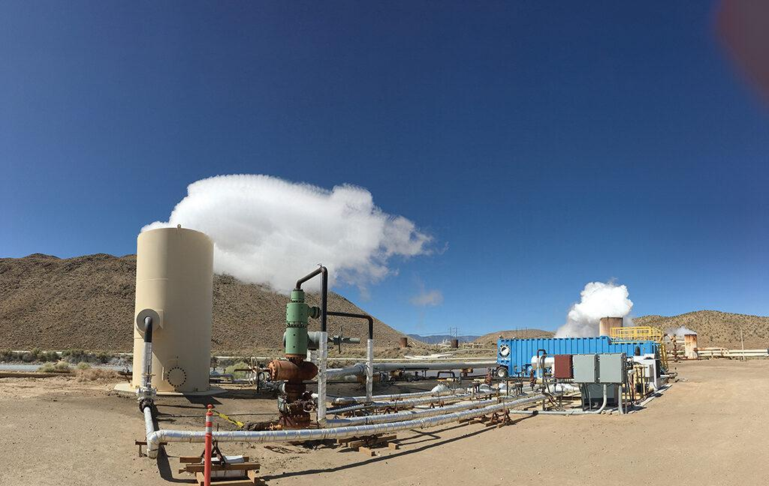
Development Discussion: Geothermal
64 Hydrothermal Wells
Max Power: 185 MW
40% of Total Energy
LCOE of $0.11

Slide 13
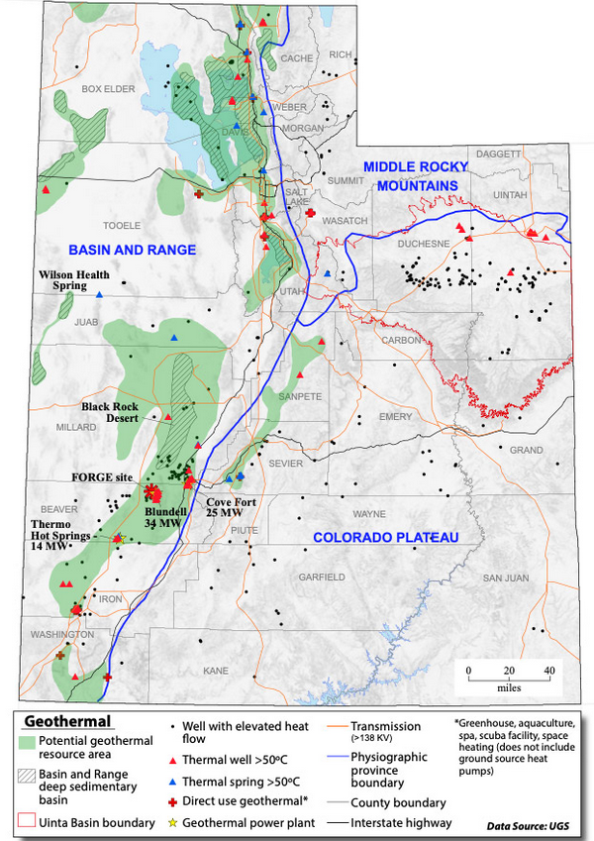

Slide 14
Cost Comparison
Current
Post Renewables
Apx. $173 a month
→ $2,076 a year
Weighted LCOE: $0.09/kWH
→ $66.90 (31 days)
→ $800 a year
> $1,000!!

Slide 15
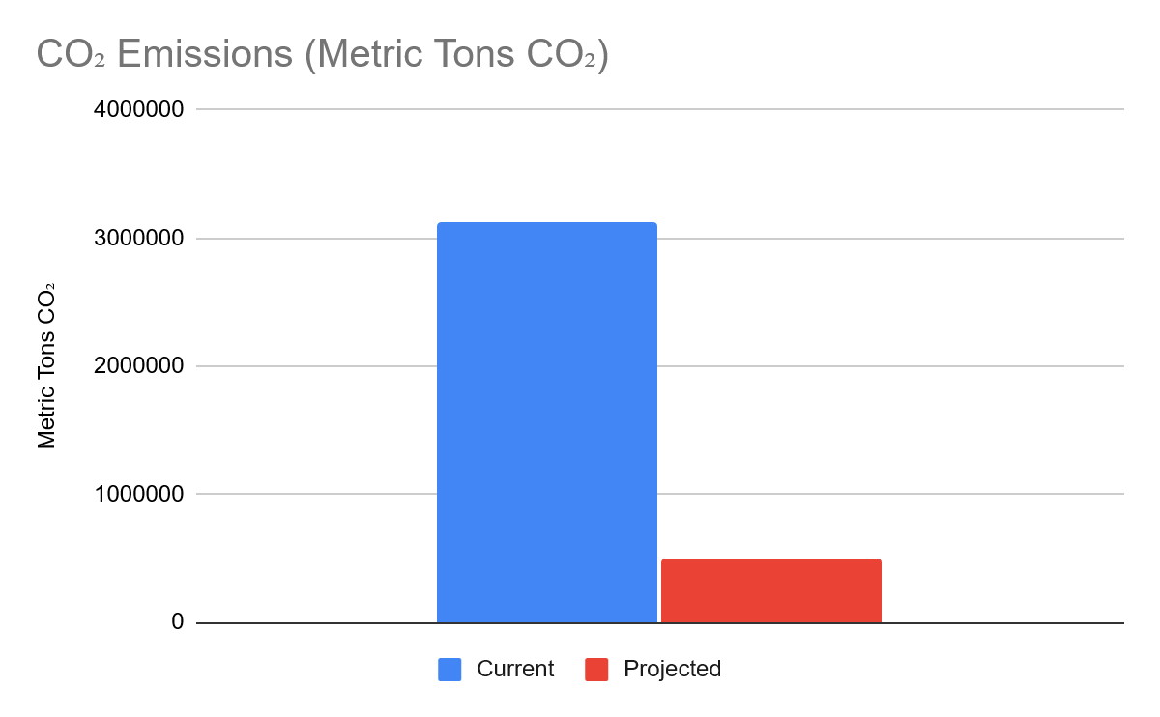
Emissions
Current: 3,118,623 Metric Tons CO₂
Post Renewables: 499,498 Metric Tons CO₂
2,619,125 Metric Tons CO₂

Slide 16
Storage

Slide 17
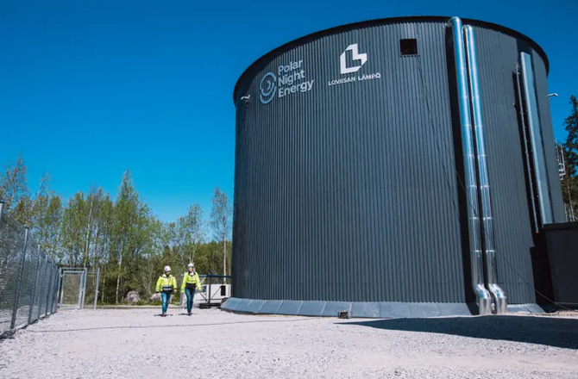
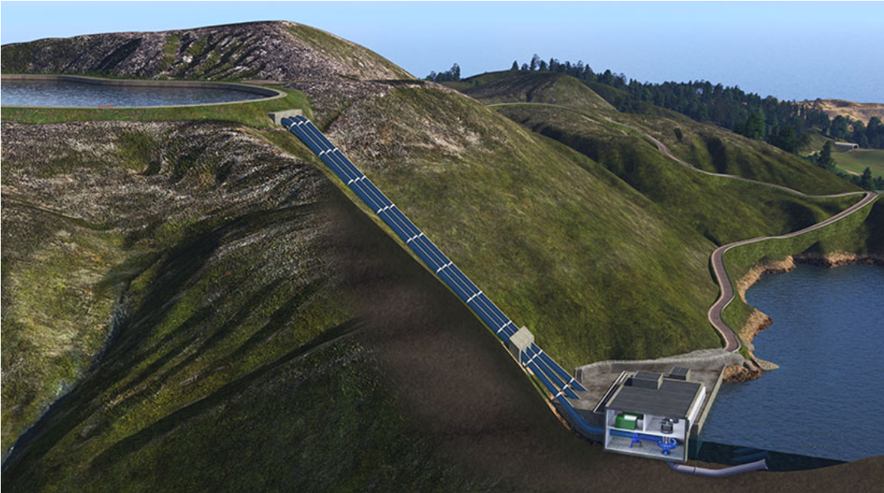
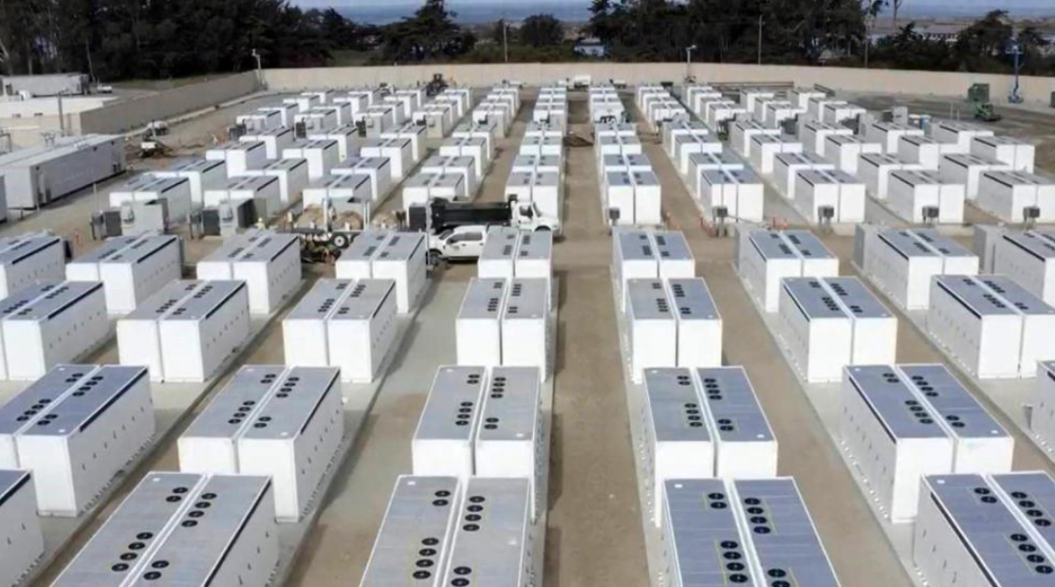
Storage
Thermal Battery
Chemical Battery
Pumped Hydro

Slide 18
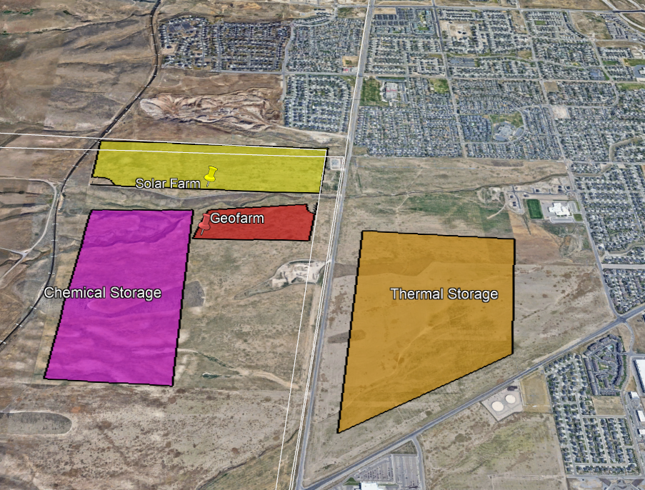
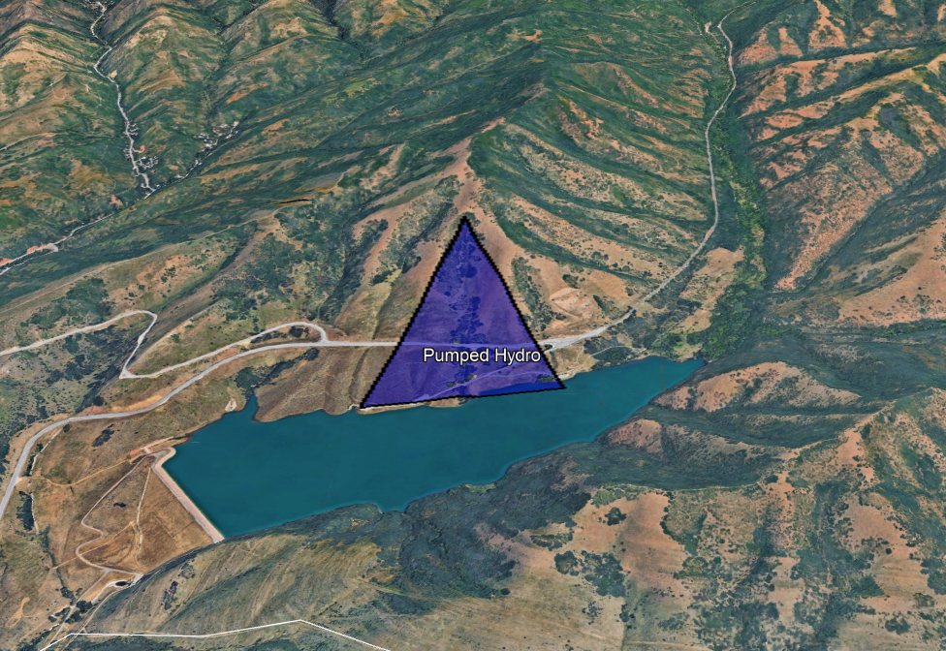
Apx. Location for Storage
Thermal/Chemical proposed locations
Pumped Hydro proposed location

Slide 19
Impacts and Mitigation
Ian Whicker

Slide 20
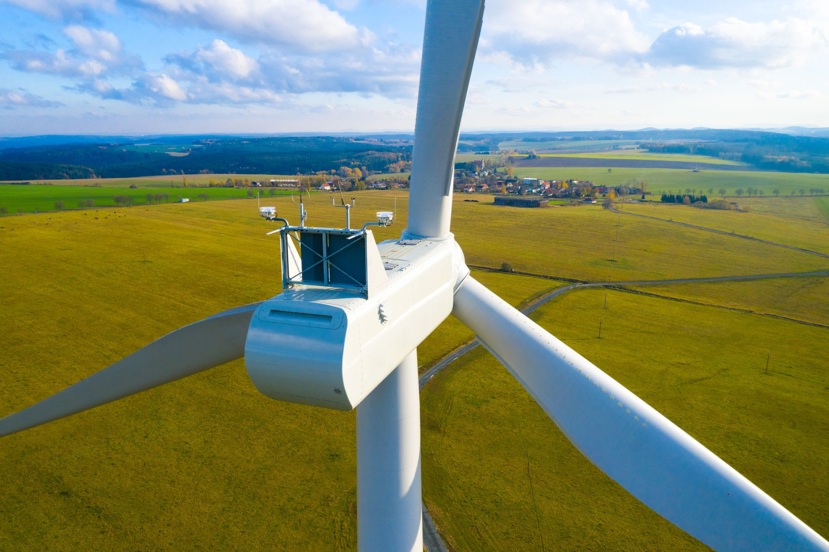
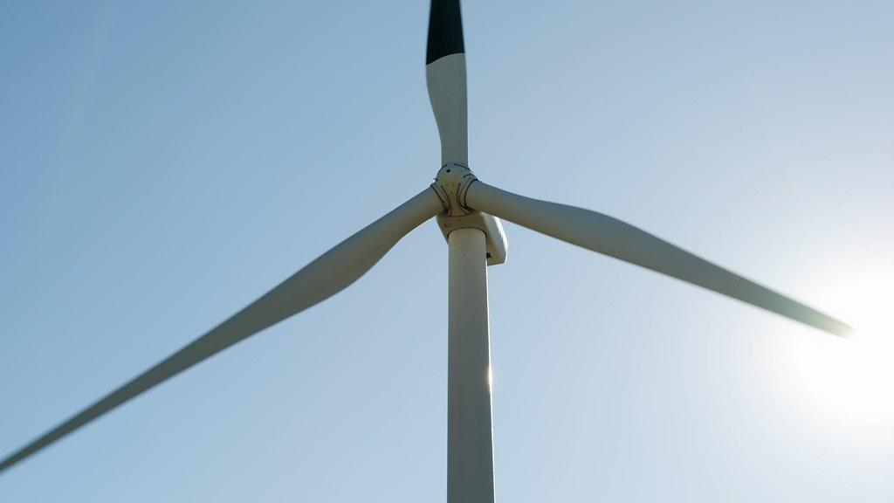
Turbines (wildlife)
Birds & Bats
Mitigation
Wind speed trackers throughout the facility.
This will lower bat related fatalities.
Bats prefer to fly in low wind conditions.
Facility powered off
Painting one blade black lowers birds hits by 72%
Land Will Be Used for Agriculture

Slide 21
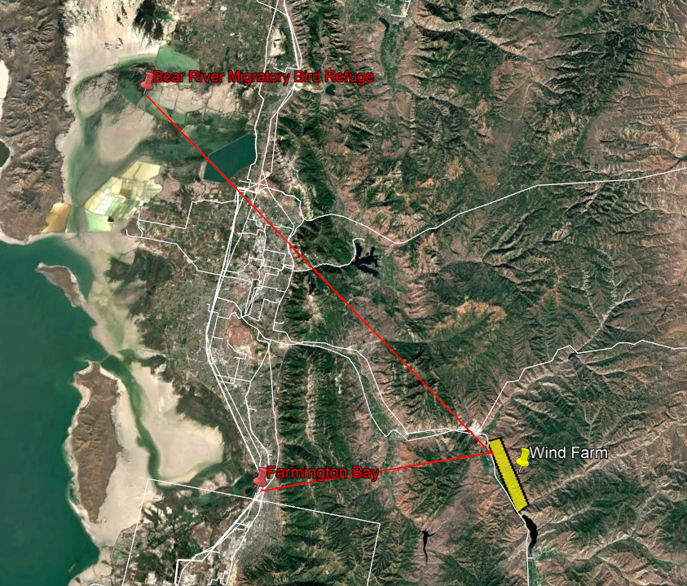

Slide 22
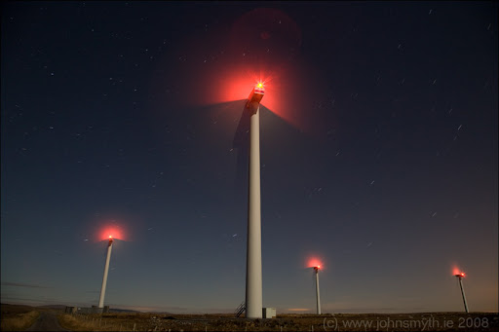
Turbines(human)
Aviation
Visual
Height of the Turbines
Night time lights
Minimal Impact
Placed Far Enough From Residential Areas
Land Used for Agriculture

Slide 23
Solar and Geothermal Impact
Solar
Geothermal
Minimal impact
Most impact during construction.
Sediment basins
Government bond for recycling
Land Will Be Used for Agriculture
Minimal impact
Closed loop system
Facility will utilize non-potable waste water

Slide 24
Storage Impact
Pumped Hydro
Chemical Batteries
Thermal Batteries
Environment
Minimal Impact
Construction Only
Visual
Impacted View of the Mountain
Fire Hazard Minimal
Chemical leak Minimal
Visual Impact
Mitigation
Reinforced Concrete Wall
Impact Minimal
Possible Release of Toxic Gas During Disposal/Failure
Mitigation
Toxic Gas Detectors

Slide 25
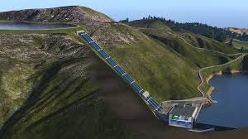
Wrap up
SUPPLY
STORAGE
Turbines
Geothermal
Pumped Hydro
Chemical Battery
Thermal Battery
PV Solar

Slide 26
Thank you

